Slide 1




Slide 2
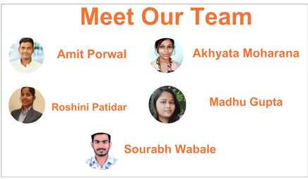


Slide 3
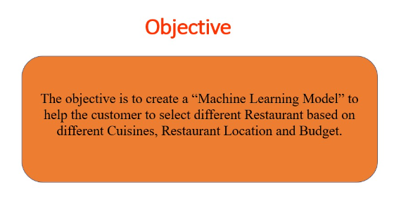

Slide 4
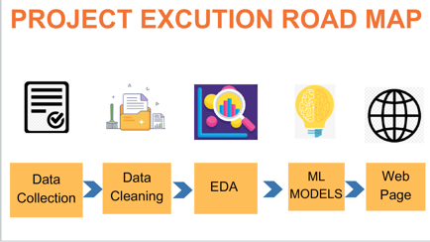




Slide 5
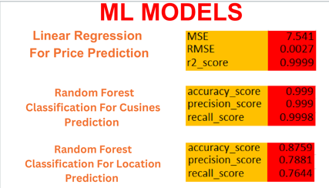

Slide 6
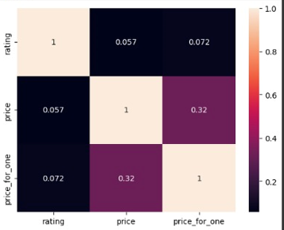

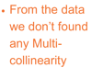

Slide 7
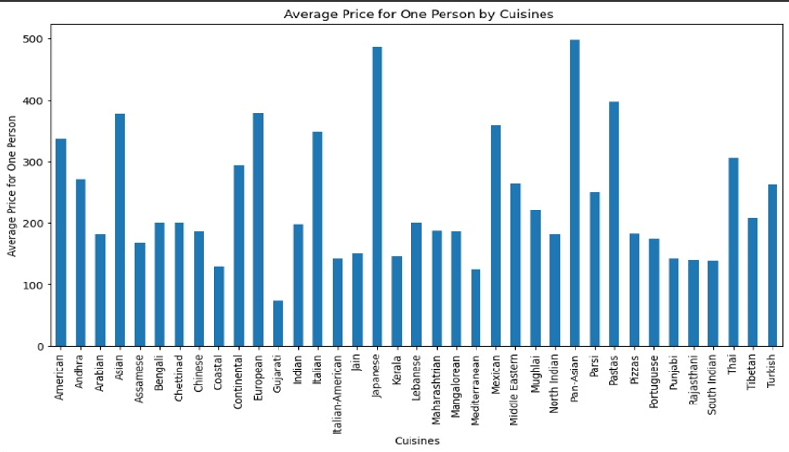

Slide 8
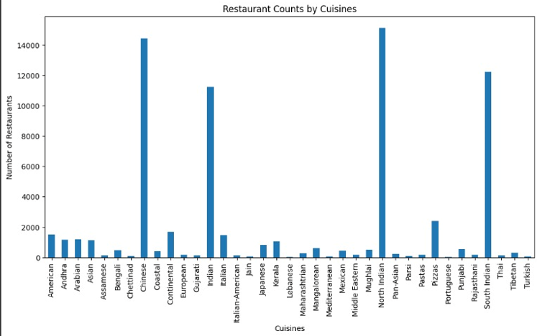

Slide 9
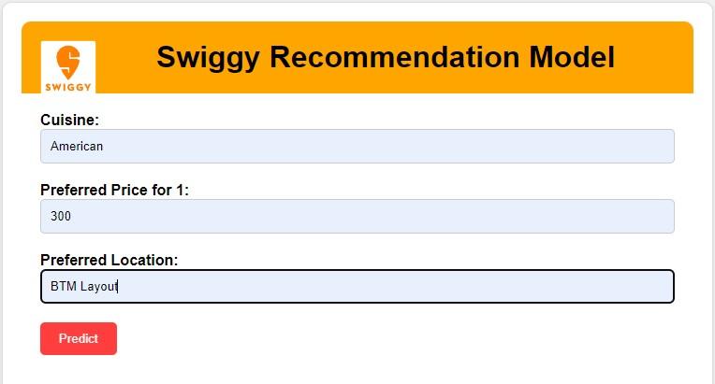
INPUT

Slide 10
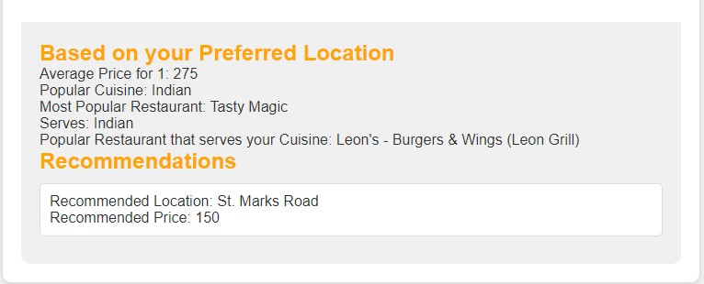
OUTPUT

Slide 11
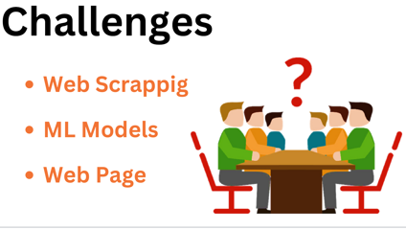


Slide 12
Flask python library
Deploy Machine Learning Model in Webpage
Basic Knowledge of CSS
Basic Knowledge of HTML tag
Scraping data from Websites
Time Management
Team Work and Coordination
LEARNING OUTCOMES

Slide 13


